Slide 1
To replace with my own drawing

Slide 2
CSS143 Computer Programming (II)

Slide 3
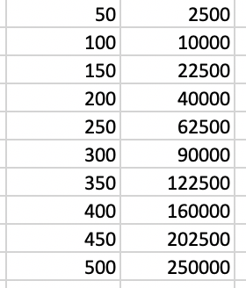
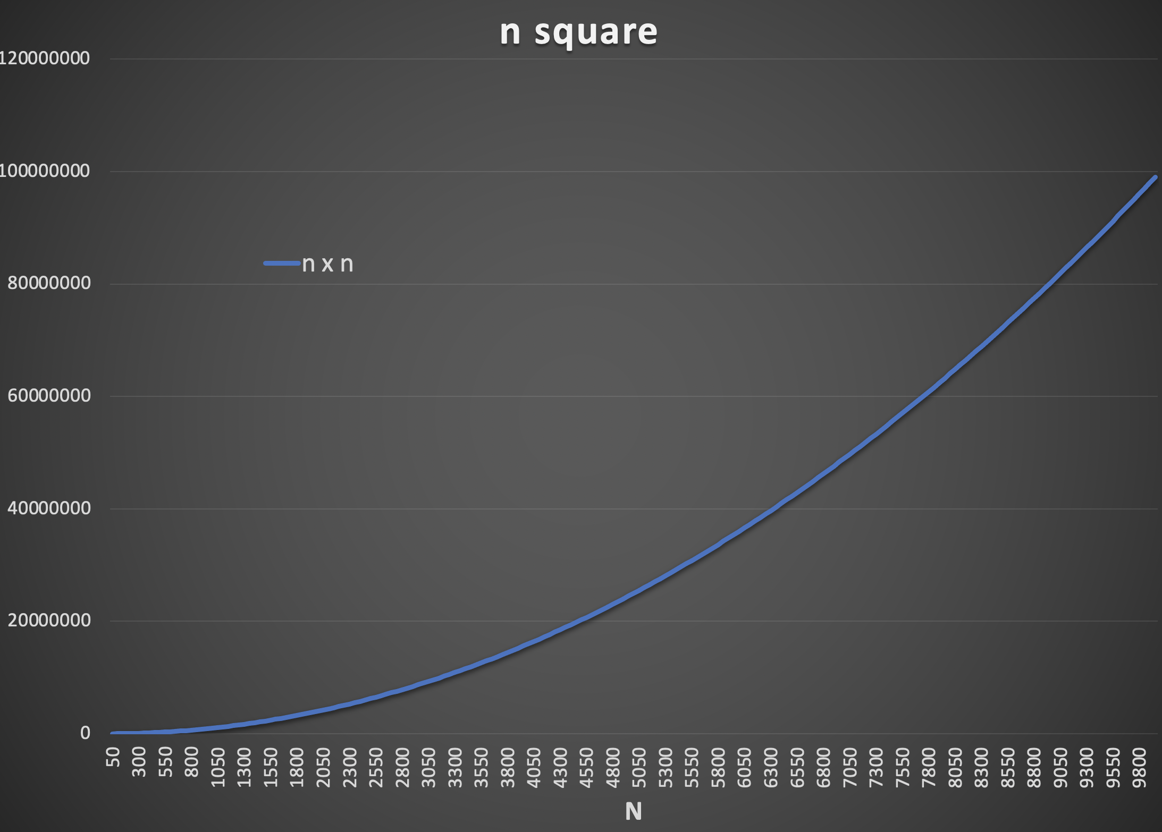
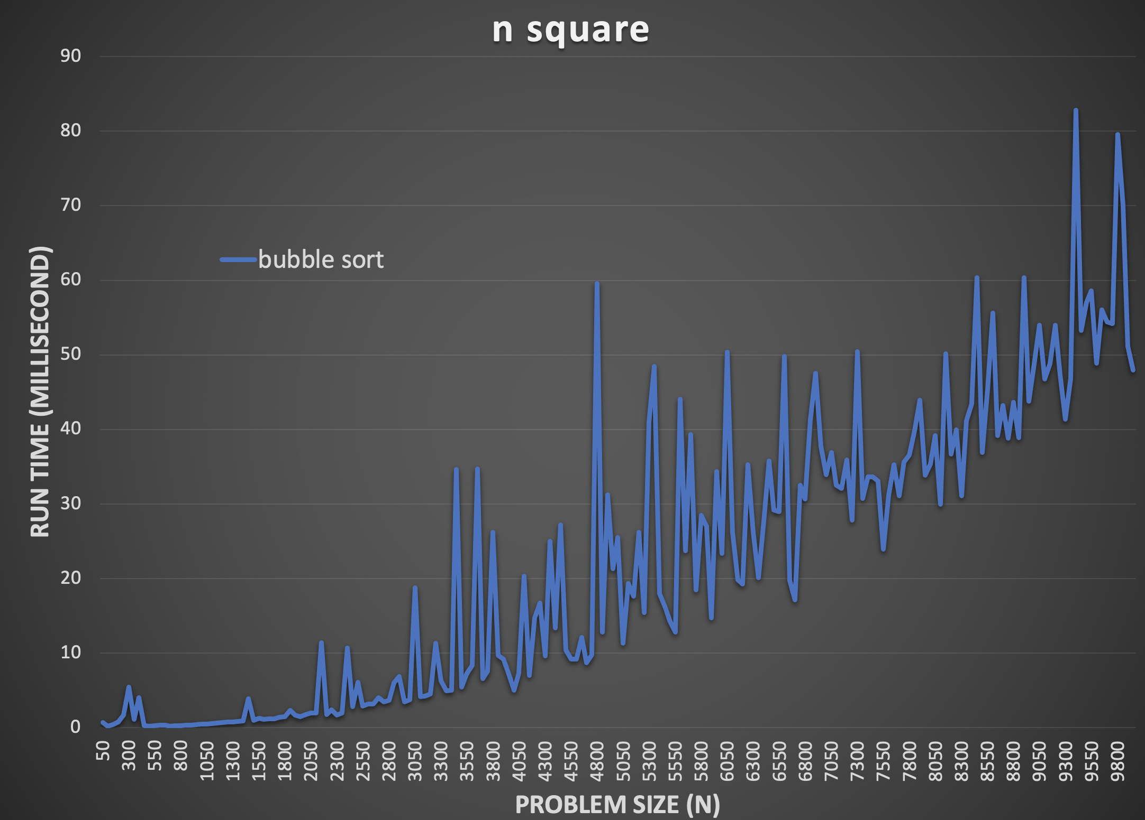
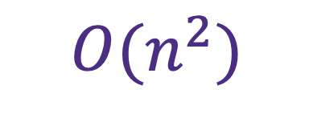
Re-cap
Bubble
Insertion
$$O(n^{2})$$

Slide 4
Re-cap
Bubble
Insertion
$$O(n^{2})$$
Can we do better than this?

Slide 5


Quicksort
Introducing….

Slide 6
Quicksort
6
5
3
Pivot

Slide 7
Quicksort
6
5
3
Pivot

Slide 8
Quicksort
9
7
6
5
3
2
1
Pivot

Slide 9
Quicksort
9
7
6
5
3
2
1
Pivot
Find a pivot and swap

Slide 10
Quicksort
3
2
1
5
9
7
6
Pivot
Sort the left side

Slide 11
Quicksort
1
2
3
5
9
7
6
Pivot
Sort the right side

Slide 12
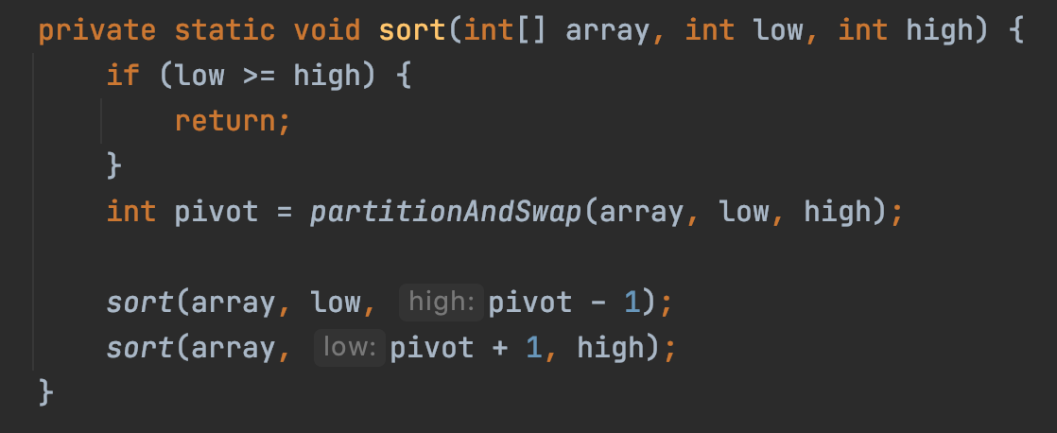

Quicksort
1
2
3
5
6
7
9

Slide 13
Pivot and Swap
9
7
6
5
3
2
1
Pivot ?
Pivot ?
Pivot ?

Slide 14
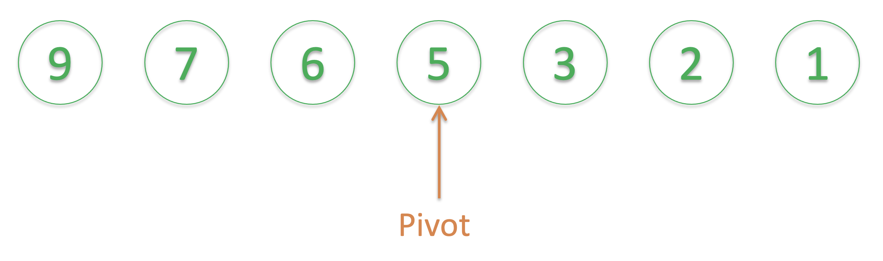
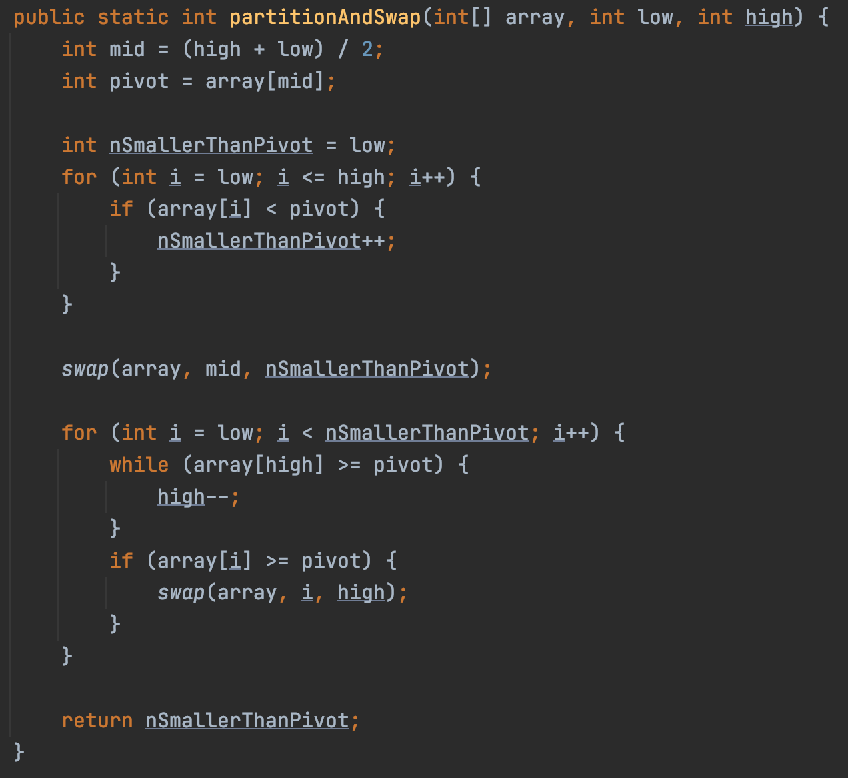
Pivot and Swap

Slide 15
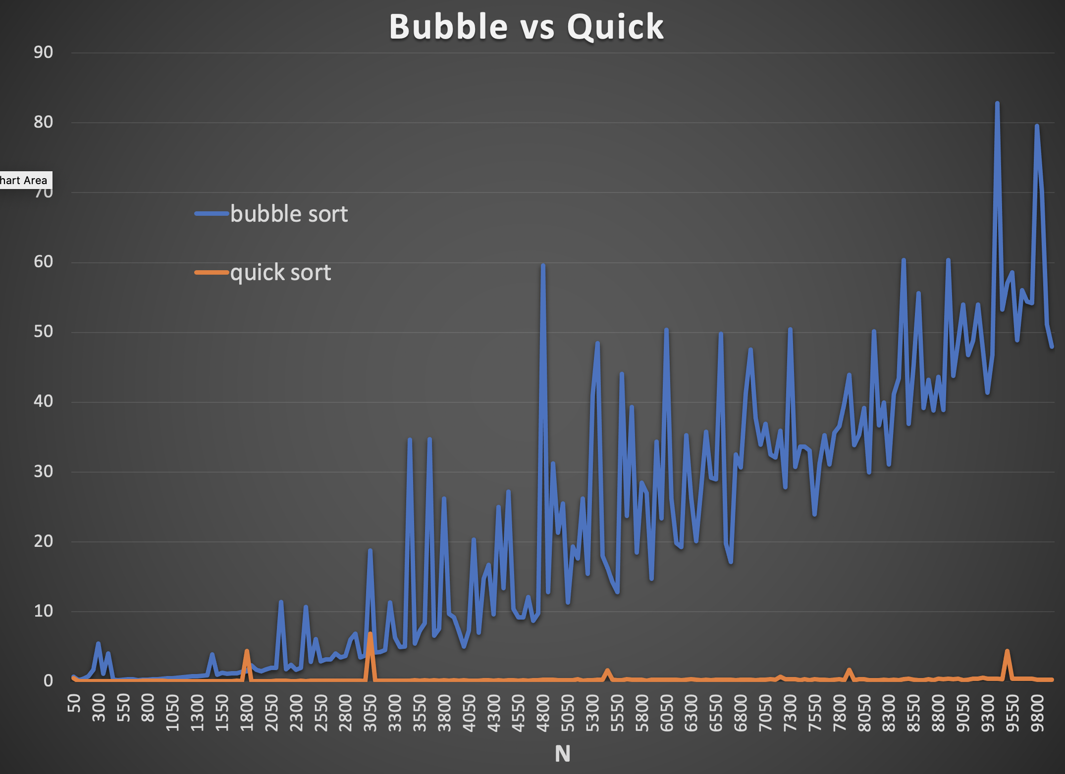

Slide 16
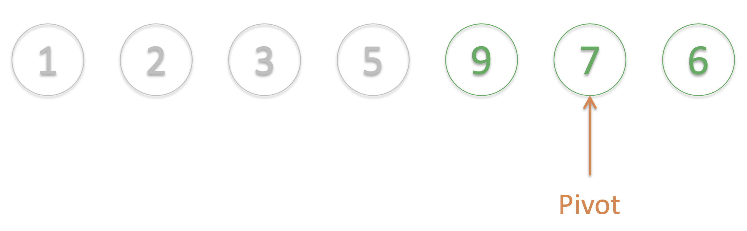
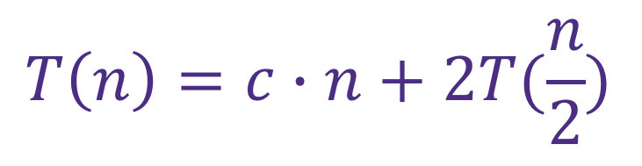
Quick Sort
Find a pivot element
Move some to left, and others to right of the pivot
Repeat
Recursion into the left of the pivot
Recursion into the right of the pivot
$$T\left(n\right)=c∙n+2T(\frac{n}{2})$$
Pivot and swap
Recursion on both sides

Slide 17
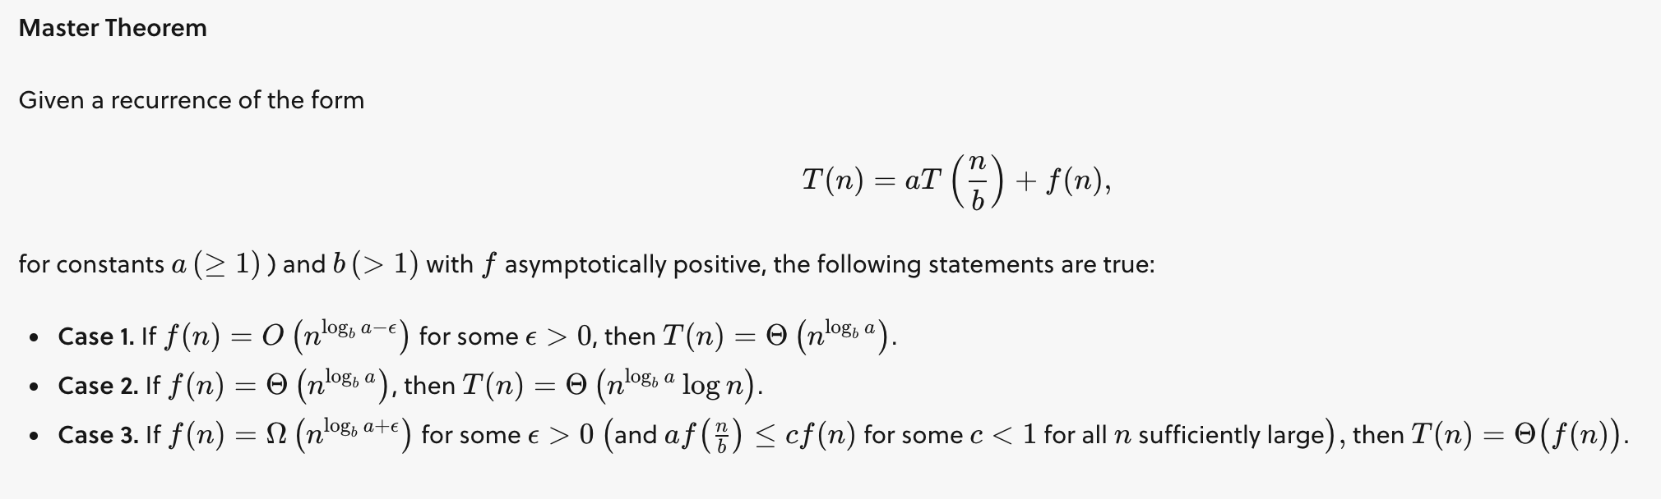
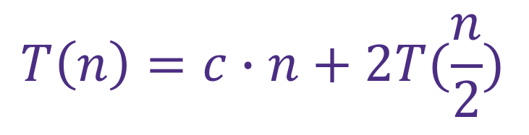
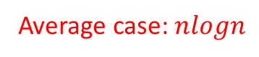
Quick Sort
$$T\left(n\right)=c∙n+2T(\frac{n}{2})$$
Pivot and swap
Recursion on both sides
Average case: $nlogn$
https://brilliant.org/wiki/master-theorem/

Slide 18
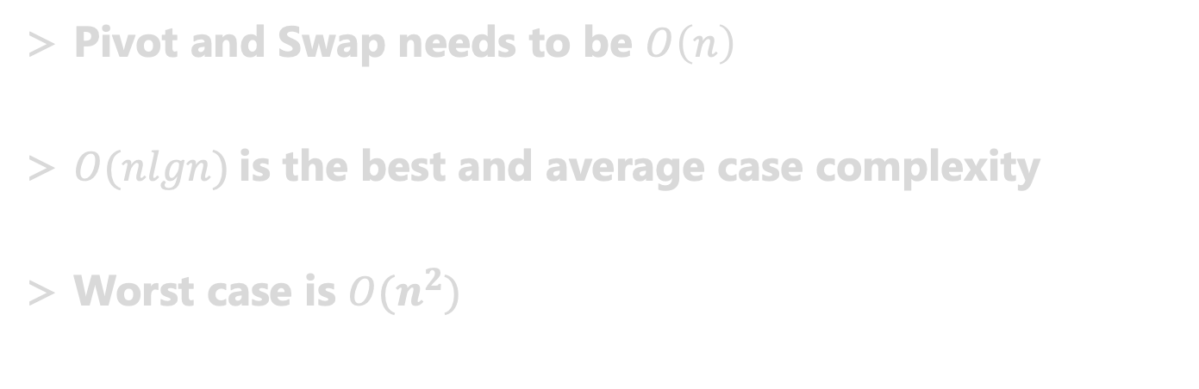
TLDR
Pivot and Swap needs to be $O\left(n\right)$
$O(nlgn)$is the best and average case complexity
Worst case is $O(n^{2})$

Slide 19
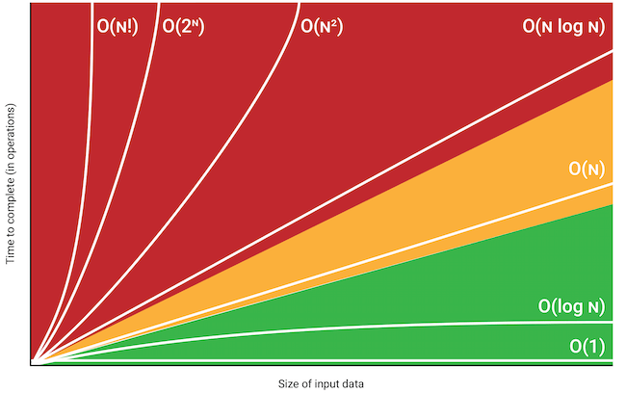
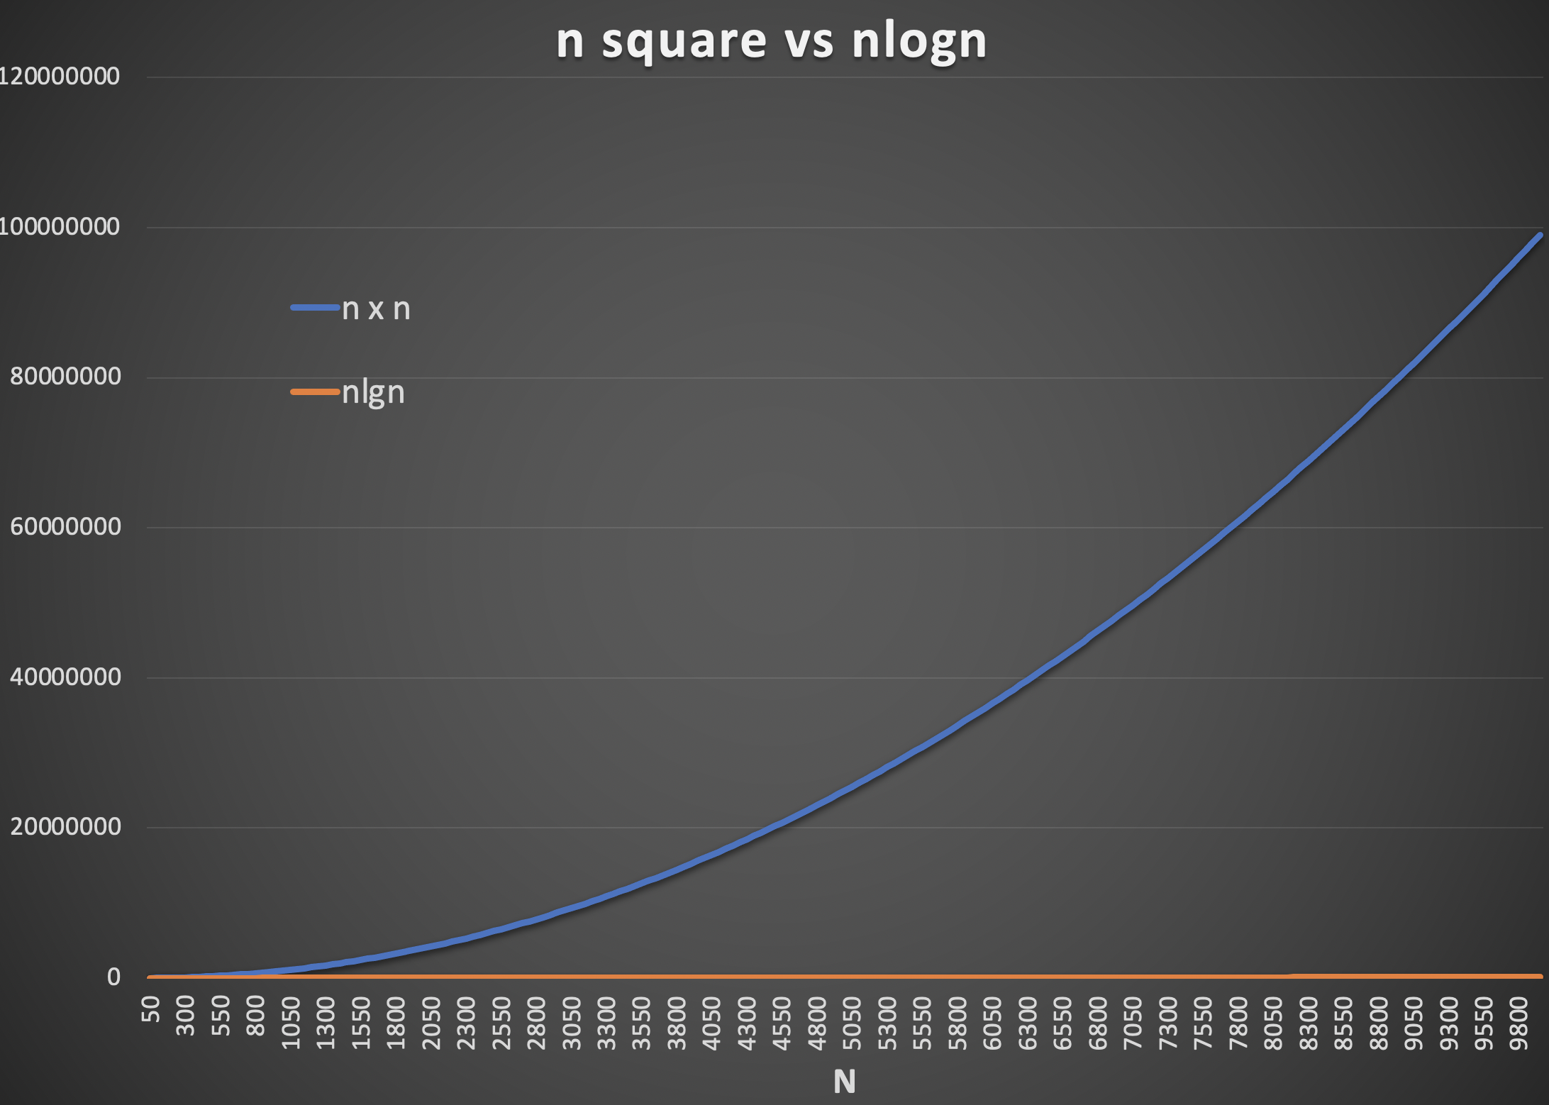
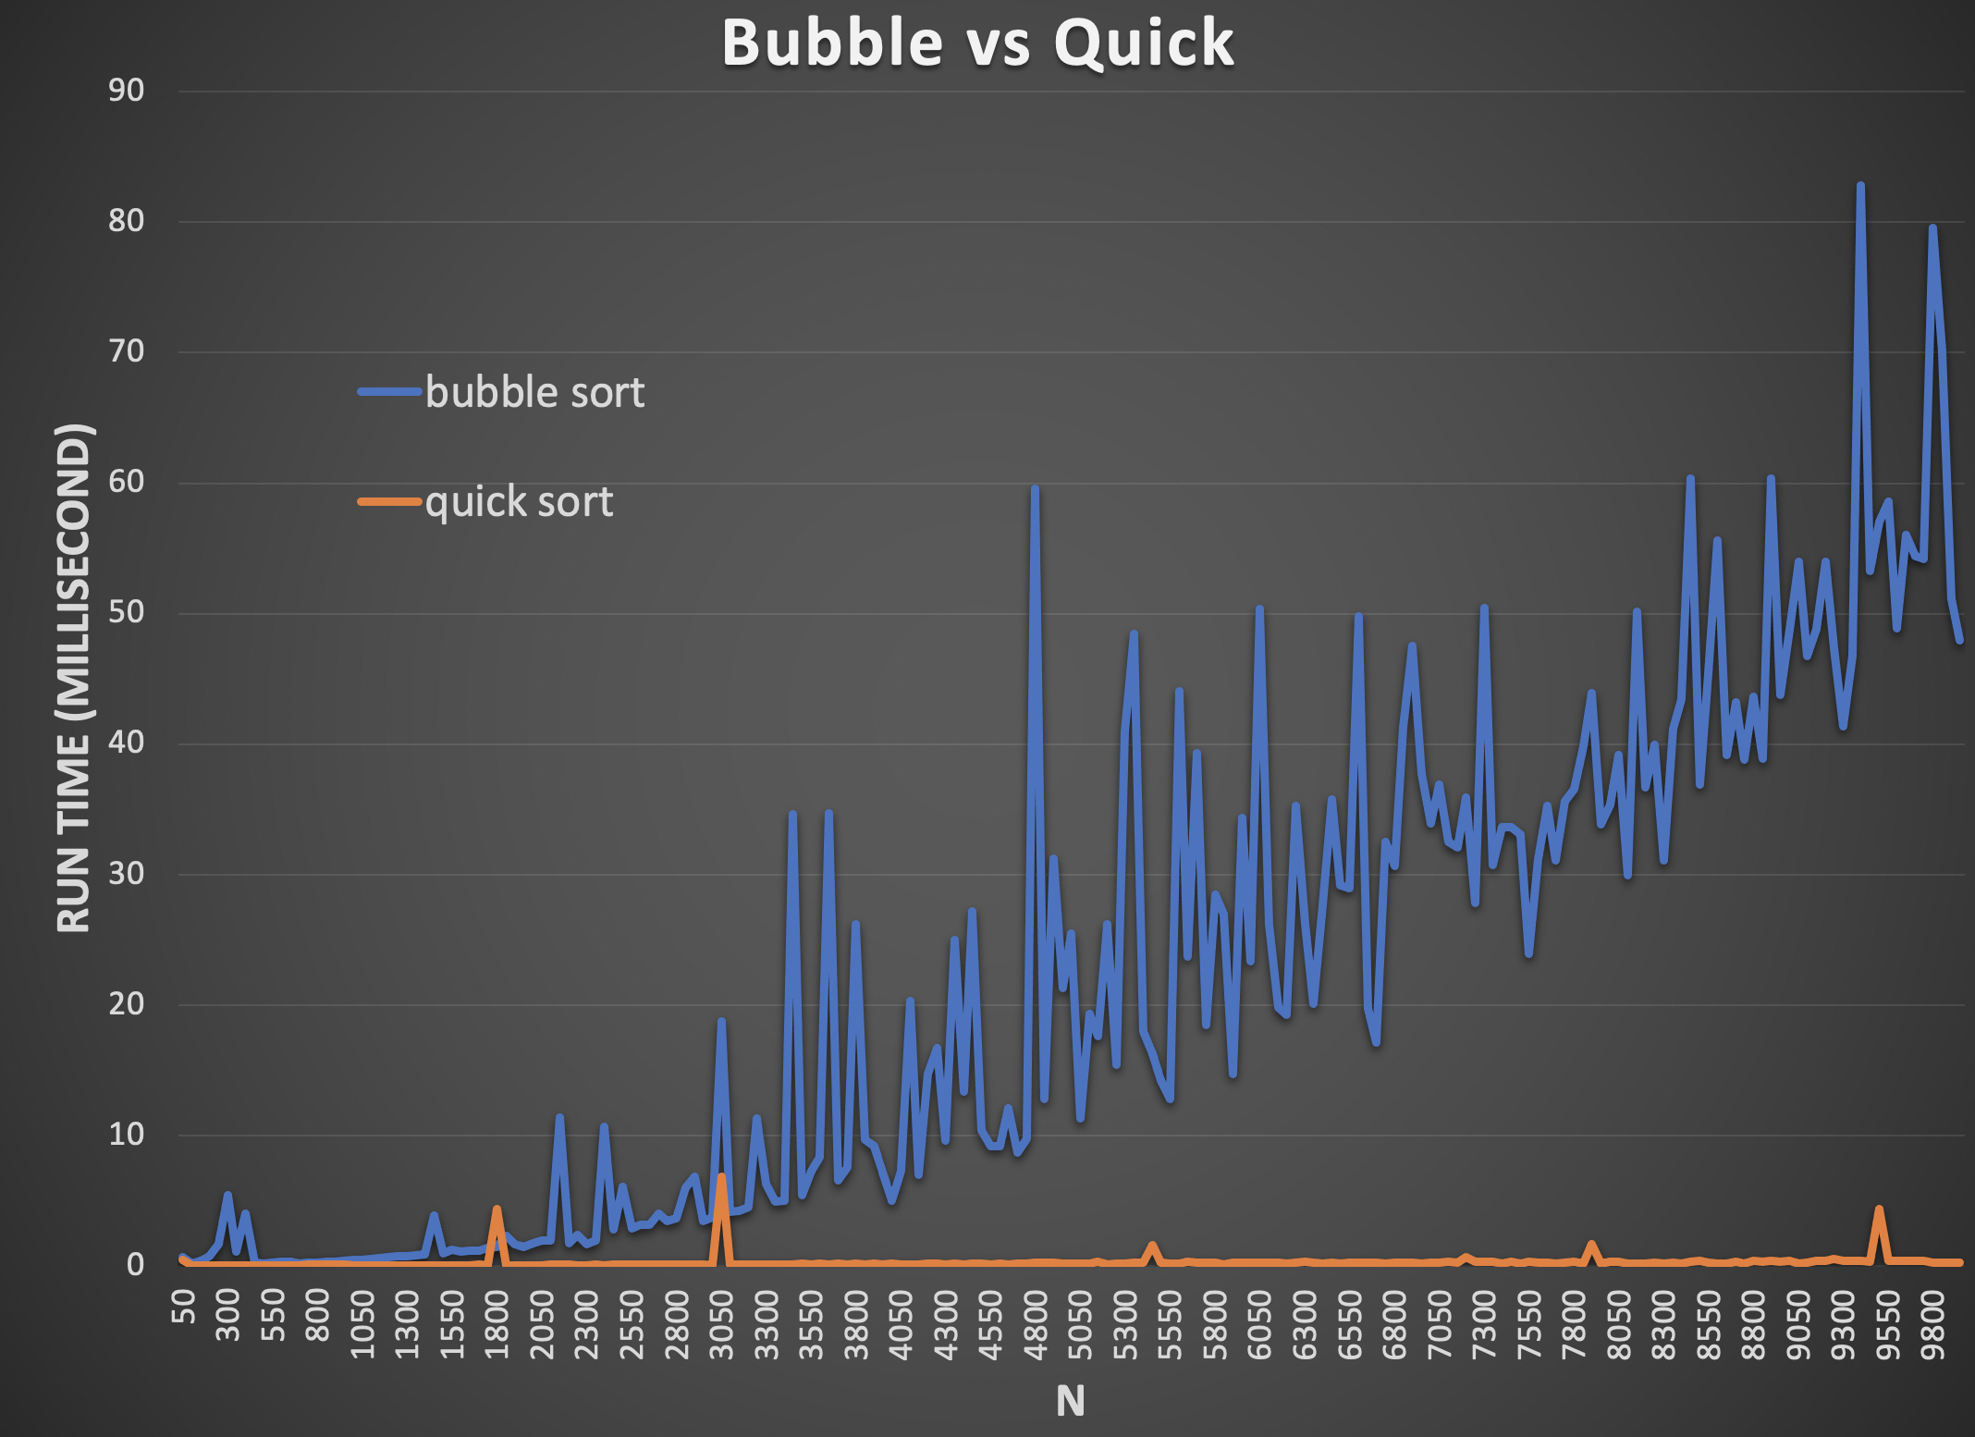

Slide 20

$$O(nlgn)$$

Slide 21
Quick Sort
9
7
6
5
3
2
1
Pivot
Pivot
How will this impact the performance?

Slide 22
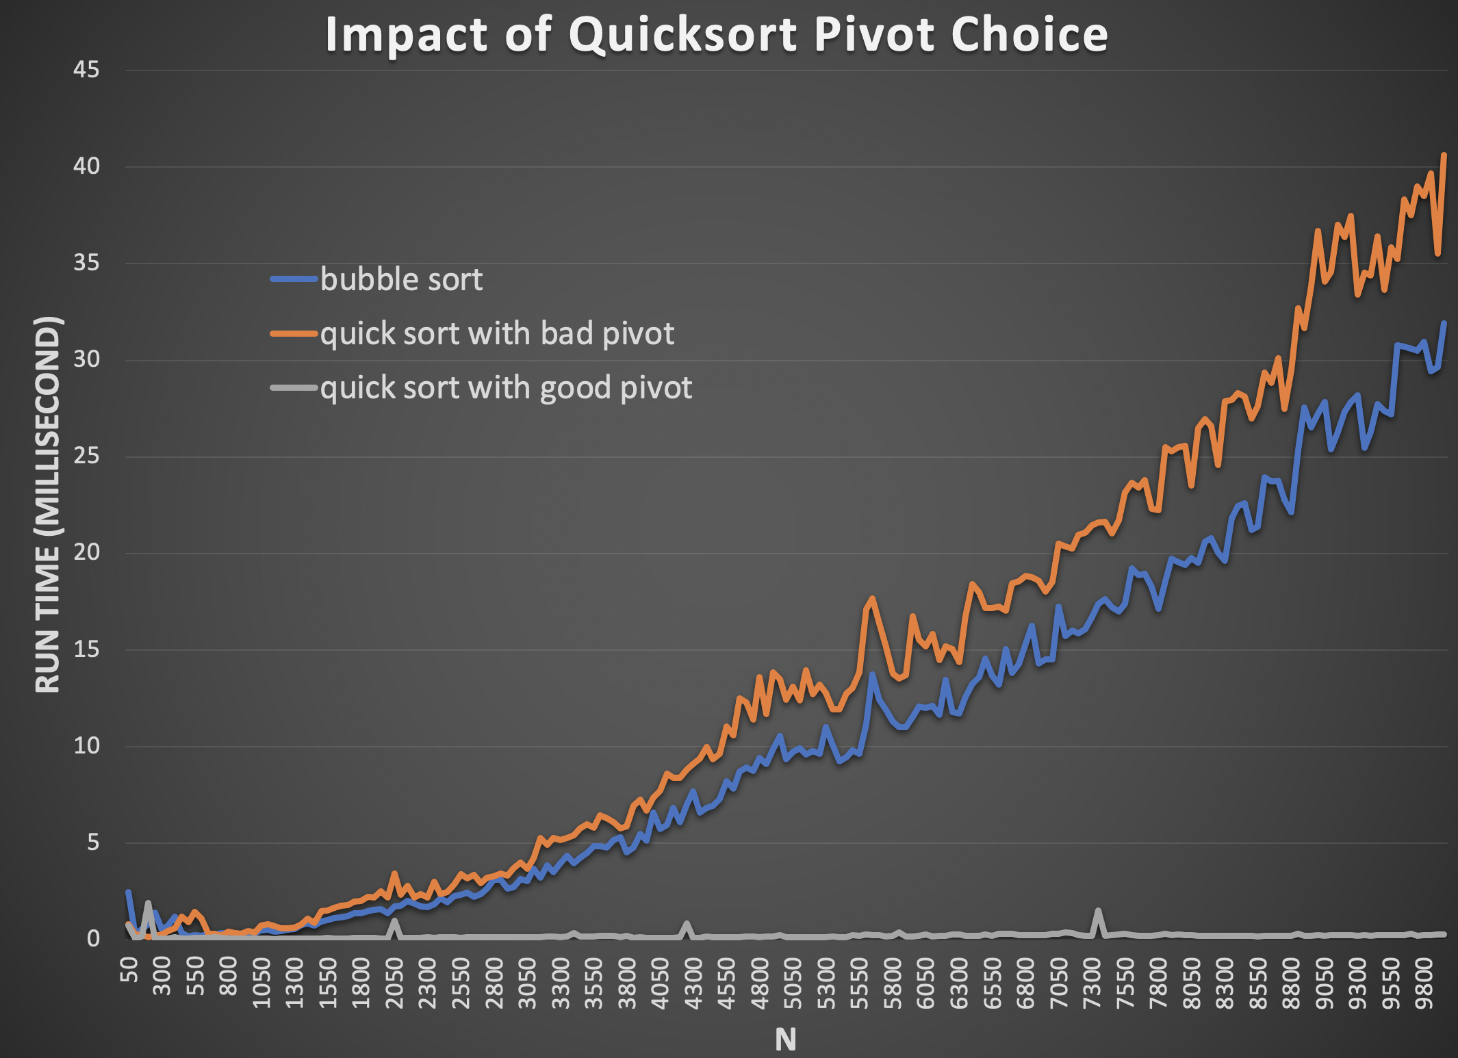


Slide 23
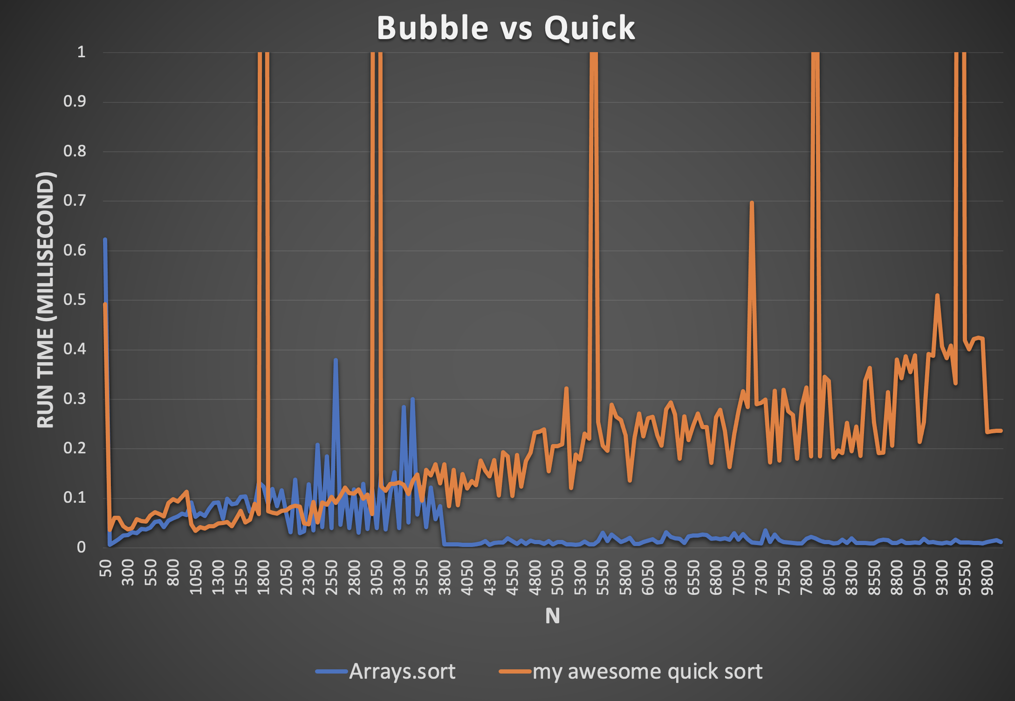

Slide 24

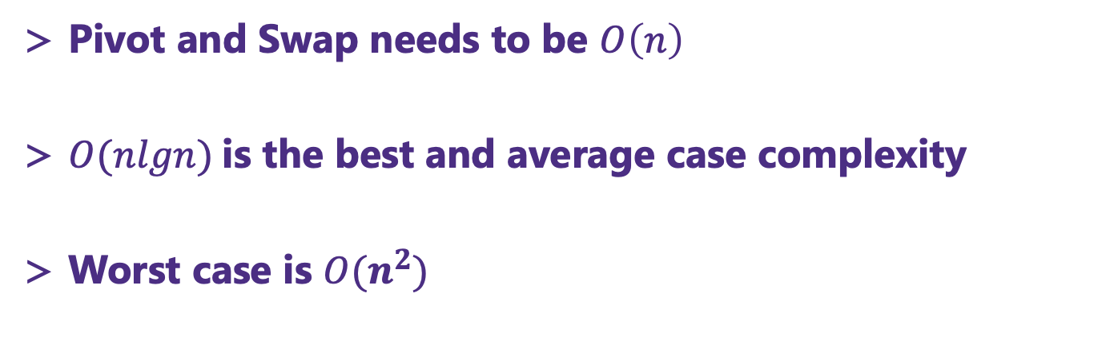
TLDR
Pivot and Swap needs to be $O\left(n\right)$
$O(nlgn)$is the best and average case complexity
Worst case is $O(n^{2})$

Slide 25
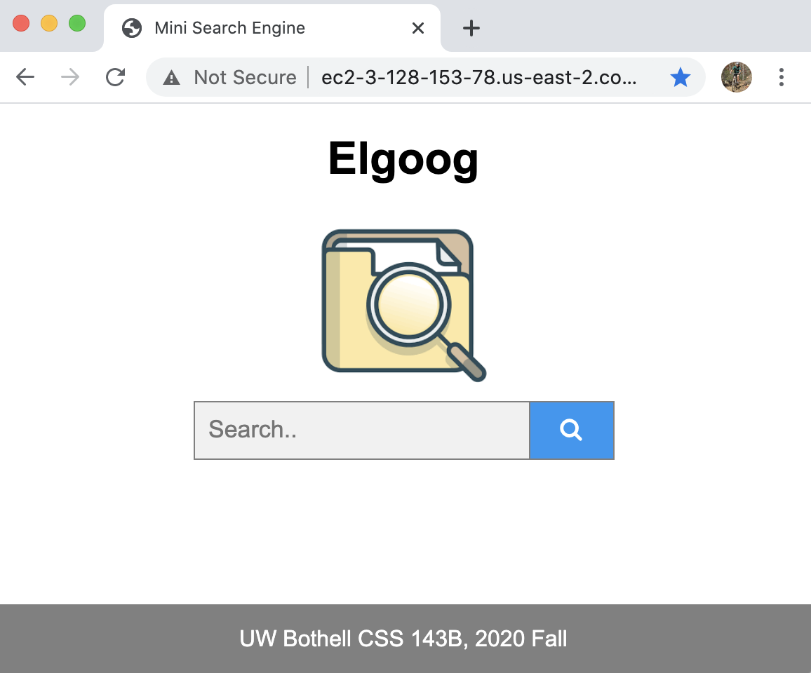
Final Project

Slide 26
Indexing
Which document contains both words
Information required for search:
“world” → documents[0,2,3,4,5]
Location of each word in each document
“world” → doc 0 {position 1}
doc 1 {}
doc 2 {position0}
doc 3 {position 0 & 1}
doc 4 {position 4}
doc 5 {position 2}

Slide 27
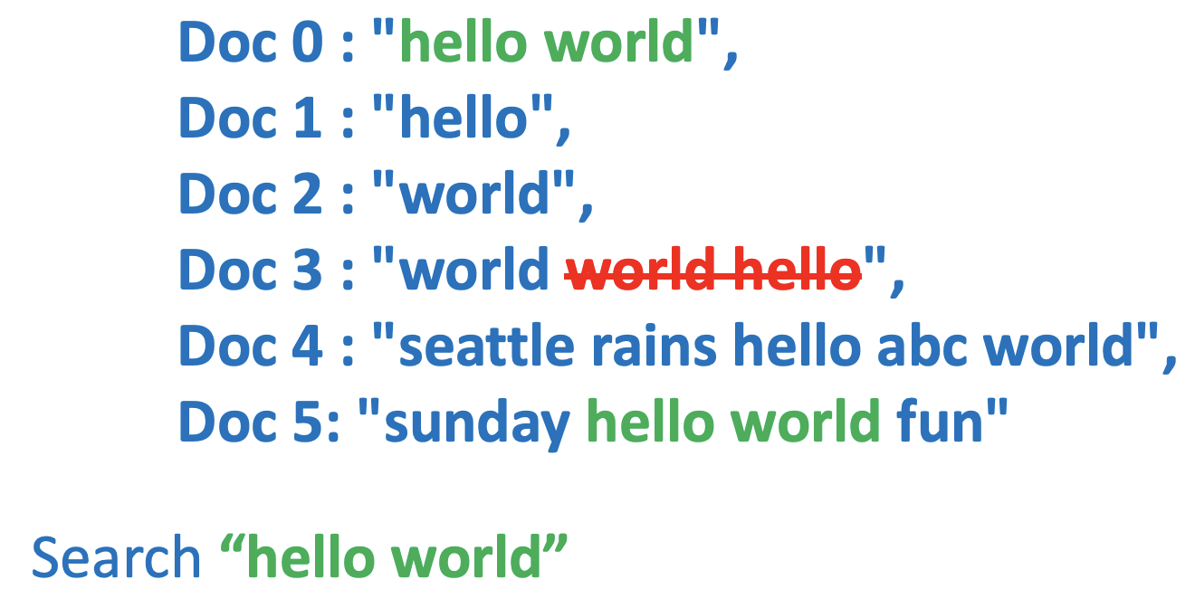
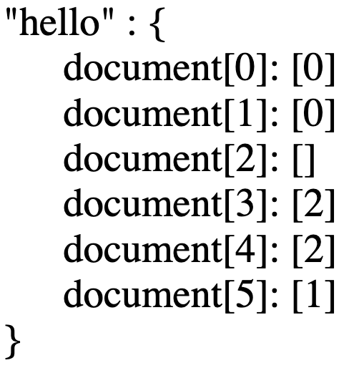
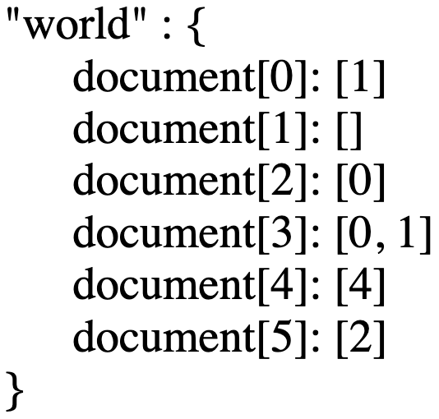

Indexing
Indexing:
word → document + location

Slide 28
Indexing
Loop through each document
Split each document (a String) by white spaces
Add the location of each word into the index map

Slide 29
hello → doc{0, location{0}}
doc{1, location{0}}
doc{3, location{2}}
doc{4, location{2}}
doc{5, location{1}}
world → doc{0, location{1}}
doc{2, location{0}}
doc{3, location{0, 1}}
doc{4, location{4}}
doc{5, location{2}}
Search “hello world”
Step one : document lists
{0, 1, 3, 4, 5}
{0, 2, 3, 4, 5}
hello
world
{0, 3, 4, 5}
doc containing both “hello” and “world"
Intersection of lists

Slide 30
Search “hello world”
{0, 3, 4, 5}
Doc containing both “hello” and “world"
hello → doc{0, location{0}}
doc{1, location{0}}
doc{3, location{2}}
doc{4, location{2}}
doc{5, location{1}}
world → doc{0, location{1}}
doc{2, location{0}}
doc{3, location{0, 1}}
doc{4, location{4}}
doc{5, location{2}}
Step two : location lists
doc 0 : {{0}, {1}}

Slide 31
Search “hello world”
{0, 3, 4, 5}
Doc containing both “hello” and “world"
hello → doc{0, location{0}}
doc{1, location{0}}
doc{3, location{2}}
doc{4, location{2}}
doc{5, location{1}}
world → doc{0, location{1}}
doc{2, location{0}}
doc{3, location{0, 1}}
doc{4, location{4}}
doc{5, location{2}}
Step two : location lists
doc 0 : {{0}, {1}}

Slide 32
Search “hello world”
{0, 3, 4, 5}
Doc containing both “hello” and “world"
hello → doc{0, location{0}}
doc{1, location{0}}
doc{3, location{2}}
doc{4, location{2}}
doc{5, location{1}}
world → doc{0, location{1}}
doc{2, location{0}}
doc{3, location{0, 1}}
doc{4, location{4}}
doc{5, location{2}}
Step two : location lists
doc 0 : {{0}, {1}}
doc 3 : {{2}, {0, 1}}
doc 4 : {{2}, {4}}
doc 5 : {{1}, {2}}

Slide 33
Search “hello world”
{0, 3, 4, 5}
Doc containing both “hello” and “world"
hello → doc{0, location{0}}
doc{1, location{0}}
doc{3, location{2}}
doc{4, location{2}}
doc{5, location{1}}
world → doc{0, location{1}}
doc{2, location{0}}
doc{3, location{0, 1}}
doc{4, location{4}}
doc{5, location{2}}
Step two : location lists
-0
-1
doc 0 : {{0}, {1}}
doc 0 : {{0}, {0}}
doc 3 : {{2}, {0, 1}}
doc 3 : {{2}, {-1, 0}}
doc 4 : {{2}, {4}}
doc 4 : {{2}, {3}}
doc 5 : {{1}, {2}}
doc 5 : {{1}, {1}}

Slide 34
Search “hello world”
{0, 3, 4, 5}
Doc containing both “hello” and “world"
hello → doc{0, location{0}}
doc{1, location{0}}
doc{3, location{2}}
doc{4, location{2}}
doc{5, location{1}}
world → doc{0, location{1}}
doc{2, location{0}}
doc{3, location{0, 1}}
doc{4, location{4}}
doc{5, location{2}}
Step two : location lists
doc 0 : {{0}, {0}}
→ 0
doc 3 : {{2}, {-1, 0}}
doc 4 : {{2}, {3}}
doc 5 : {{1}, {1}}
→ 5

Slide 35
Bridge Crossing
4 people A, B, C and D to cross a bridge in the night.
Bridge can only hold two people at a time.
They have one torch which must be used when crossing the bridge. And the torch only last 15 minutes.
Bridge crossing time
A: 1 minute
B: 2 minutes,
C: 5 minutes, and
D: 8 minutes.

